Slide 1



ANALYZING USER FEEDBACK FOR ERROR DETECTION
-ARAVIND MORIGADI
SANDEEP SANGVI

Slide 2
Table Of Content
01
Introduction
02
Literature Review
03
Corpus Acquisition
04
Approach
05
Implementation
06
Experimental Setup
07
08
Analysis of results
09
Future Work
Results

Slide 3

Introduction
This project simplifies how developers handle user feedback and log data by using NLP technique. Our goal is to speed up error detection and resolution, helping developers fix problems faster and more effectively which speeds up error detection and resolution, improving app quality and user satisfaction.
Research
Evaluate both traditional machine learning models and state-of-the-art transformer models like DistilBERT.
Motivation
Problem Statement
Sentiment analysis helps in understanding user feedback, enabling businesses to refine services.
The project addresses challenges like handling large volumes of unstructured user feedback and logs, which complicate issue identification and prioritization. Additionally, the slow and time-consuming error detection process delays resolution efforts.

Slide 4

Literature Review
The literature highlights key advancements in software engineering using NLP and machine learning techniques. Guzman et al. (2014) explored sentiment analysis to interpret user emotions in bug reports and reviews, enhancing software quality, while Antoniol et al. (2008) introduced automated bug report categorization, enabling faster issue resolution through NLP techniques. He et al. (2018) proposed hybrid approaches combining statistical methods and machine learning for anomaly detection in software monitoring, ensuring efficient issue identification.
Traditional models like Logistic Regression and SVM, paired with word embeddings such as GloVe, provide strong baseline performance, but recent developments in transformer-based models like DistilBERT, fine-tuned on domain-specific data using HuggingFace tools, significantly improve context understanding and accuracy in software-specific tasks.

Slide 5


Corpus Acquisition & Approach
01
02
03
04
NLP Techniques& LLM Models
Corpus Acquisition
Data Collection
Data Preprocessing
Preprocessing steps include lowercasing, tokenization, removing stopwords, and feature extraction using GloVe embeddings and TF-IDF. Convert text to lowercase, remove special characters, and tokenize.
Remove stopwords using NLTK.
Traditional models like Logistic Regression, Random Forest, SVM, and XGBoost are combined with transformer-based techniques, such as fine-tuning DistilBERT for superior contextual understanding. Evaluation metrics include Accuracy, Precision, Recall, and F1-Score.
The project uses Kaggle's "Reviews for Classification" dataset with 26,966 labeled records, categorizing sentiments as positive, negative, or neutral based on customer reviews.
The dataset comprises 26,966 customer reviews sourced from Kaggle, labeled for sentiment analysis into positive, negative, or neutral categories, providing a robust foundation for training and evaluation.

Slide 6

Implementation
Libraries Used
Python: Pandas, sklearn, HuggingFace’s transformers.
Pretrained Models: GloVe for embeddings and DistilBERT for transformer-based classification.
Key Steps for DistilBERT
1. Fine-tuned DistilBERT on the dataset for 26966 samples (for computational efficiency).
2. Tokenized text with HuggingFace tokenizer
3. Used DistilBERT’s classification head for predictions.
2. Github code uploaded link
Presentation is a public speaking activity that aims to convey a message
or information. The things conveyed can be in the form of ideas, ideas,

Slide 7

Experimental Setup
01
02
03
Experiment
Procedure
Test
For DistilBERT: Used fine-tuning on a subset of data (26966 records) due to resource constraints.
For ML models: Trained using extracted features (GloVe embeddings).
Compare traditional models with DistilBERT in predicting sentiments (positive, neutral, and negative).
Measure performance on the same dataset split for both traditional ML models and DistilBERT.

Slide 8
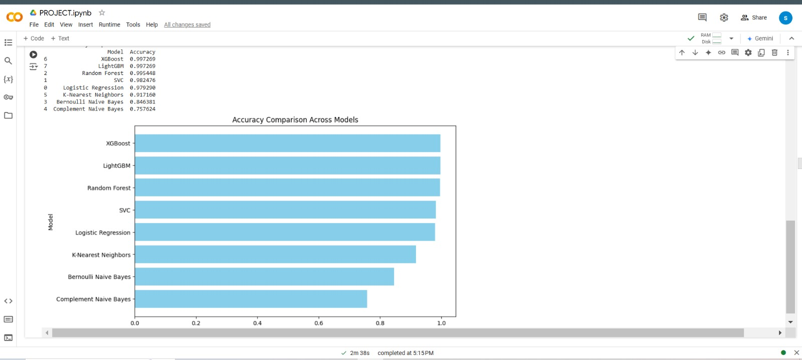
Results:
Machine Learning Approaches
Traditional machine learning models like Logistic Regression, Random Forest, and SVM achieved moderate performance in sentiment classification, with XGBoost providing the best accuracy among them.
GloVe embeddings effectively captured semantic features, improving model outcomes.

Slide 9
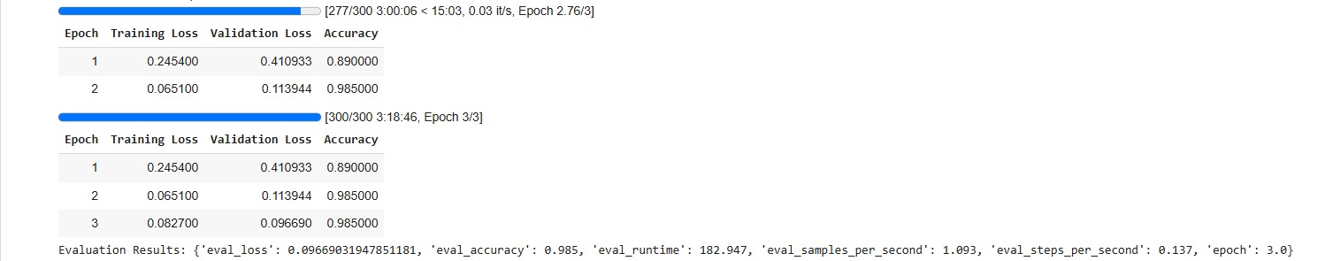
DistilBERT Performance:
Fine-tuned Hybrid DistilBERT significantly outperformed traditional methods, achieving higher accuracy (98%) and better handling of nuanced contexts, especially in neutral and negative sentiments.

Slide 10
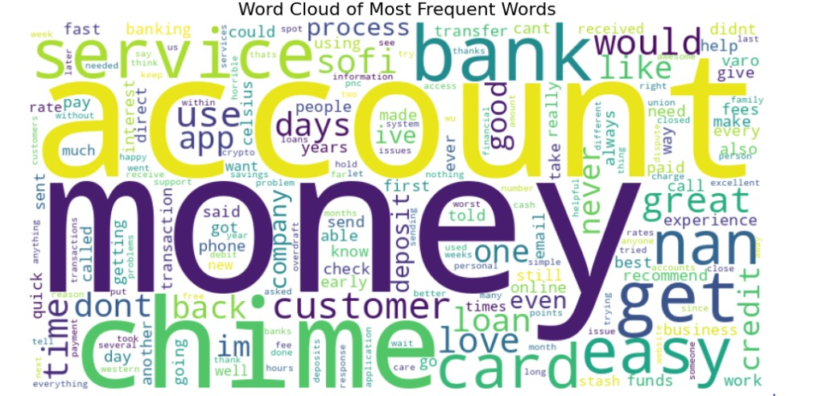
2. Word Cloud
Word cloud representations highlighted key sentiment-bearing words in positive, neutral, and negative reviews.

Slide 11
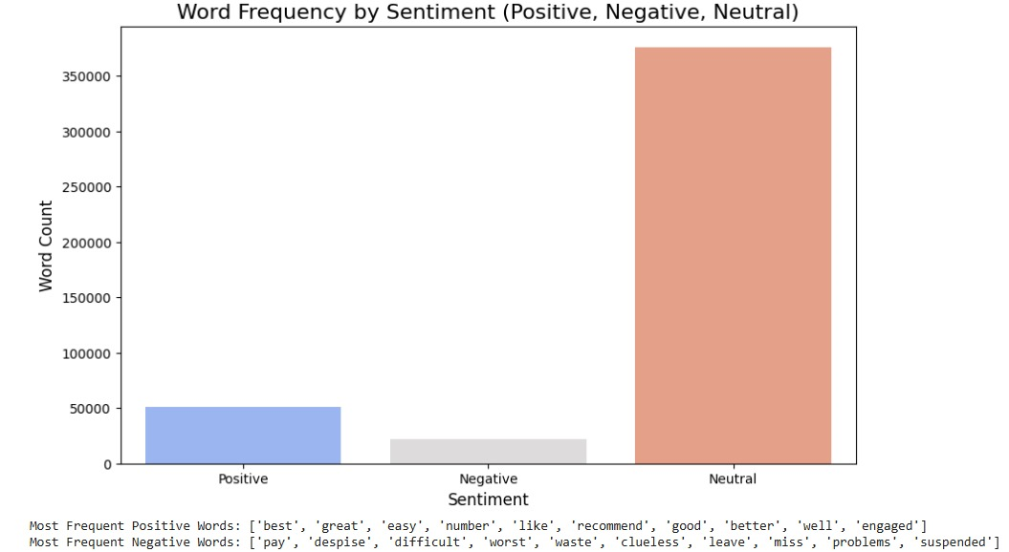
3. Sentiment Analysis
Bar charts displayed the frequency of the most used sentiment-related terms, emphasizing the dataset's balanced sentiment distribution.

Slide 12


Discussion & Analysis of Results
Insights
Hybrid DistilBERT captures nuanced meanings, making it robust for handling imbalanced datasets and complex texts.
Traditional ML models are cost-effective and interpretable but lack deep contextual understanding.
Challenges
Resource constraints during Hybrid DistilBERT fine-tuning required dataset size reduction.
Overhead in deploying transformer models compared to traditional ones.

Slide 13

Future Work:
Real-time sentiment analysis integration in business tools. The project focuses on using sentiment analysis to monitor customer satisfaction and prioritize issues in real-time. It includes live feedback processing, addressing critical negative reviews, and enhancing chatbots for empathetic and dynamic responses.

Slide 14

Meet Our Team
Aravind Morigadi
Data preprocessing and integration of GloVe embeddings.
Sandeep Sangvi
Implementation and evaluation of ML models & Fine-tuning DistilBERT and result analysis.

Slide 15

THANK YOU
FOR YOUR ATTENTION& TIME

